Slide 1

DR. VIRENDRA SWARUP INSTITUTE OF COMPUTER STUDIES
PRESENTED BY:
GROUP 11
Members of group are-
Sneha Kashyap
Saumya Ludhwani
Sameer
4

Slide 2



AWS
CLOUD
COMPUTING

Slide 3
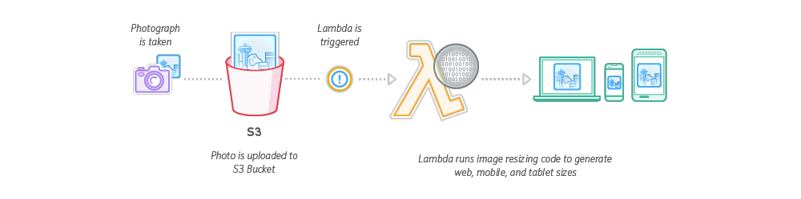
PROJECT- 1
SERVERLESS IMAGE RESIZING

Slide 4
Serverless computing abstracts server management and infrastructure, allowing developers to focus solely on writing code.
AWS Lambda is a serverless compute service that executes code in response to events, such as HTTP requests or changes to data in AWS services.
A serverless architecture is a way to build and run applications and services without having to manage infrastructure

Slide 5
BENEFITS OF SERVERLESS IMAGE RESIZING
•AUTOMATIC SCALING-AWS lambda ensures optimal performance even during traffic spikes.
•COST EFFECTIVE- You pay only for the actual compute time used with no upfront costs or ideal capacity expenses.
•SIMPLIFIED MAINTENANCE- Serverless architecture reduces operational overhead as AWS manages the underlying infrastructure.

Slide 6
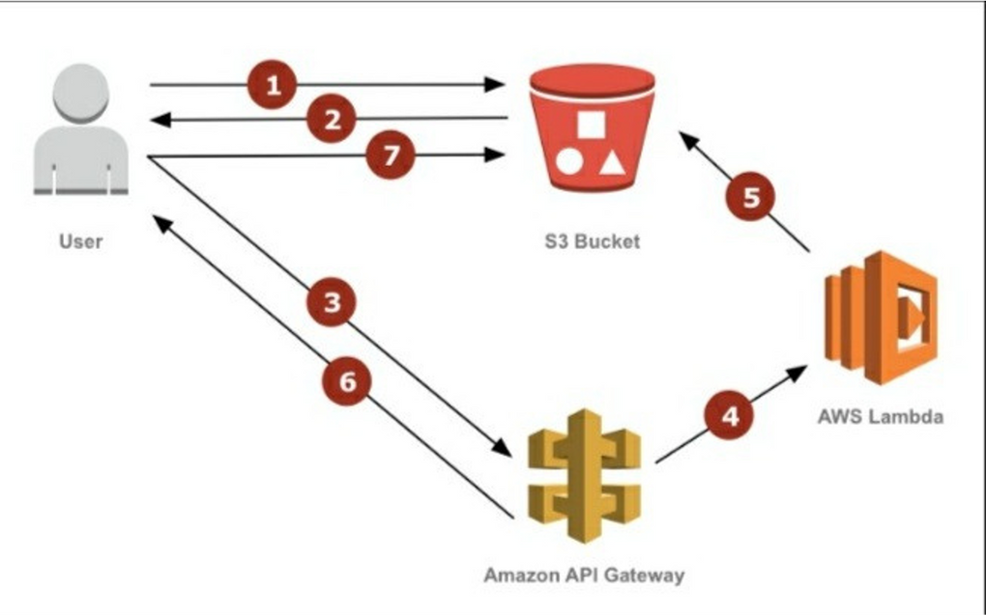
IMAGE RESIZING WORKFLOW
When an image is uploaded a trigger invokes a lambda function.
The lambda function fetches the original images from S3 and resizes it using an image processing library.
The resized image is then stored back in S3 or sent to other services as needed
6

Slide 7
AWS Services Used
Amazon S3-- Stores the original and resized image.
AWS lambda-- Executes the image resizing function.
18

Slide 8
SETTING UP THE ENVIRONMENT
STEP 1-Create an S3 bucket to store the original and resized images.
STEP 2-Create a lambda function using desired programming language(e.g.,python,node.js).
STEP 3-Configure the lambda function to receive S3 events
18

Slide 9
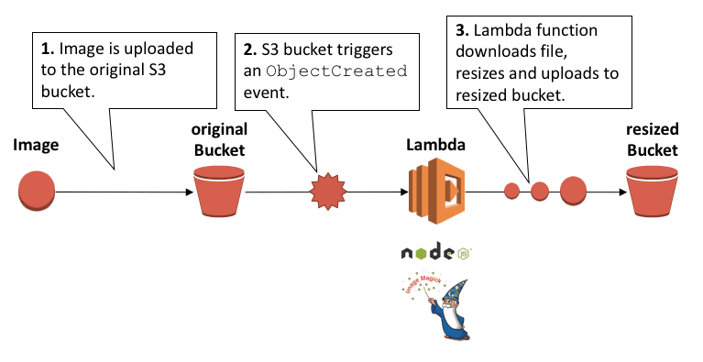
CONCLUSION
SERVERLESS IMAGE RESIZING WITH AWS LAMBDA AND OTHER SERVICES OFFERS A SCALABLE,COST EFFECTIVE AND EFFICIENT SOLUTION.
BY LEVERAGING SERVER LESS COMPUTING ,DEVELOPERS CAN FOCUS ON DELIVERING VALUE TO USERS.
8

Slide 10
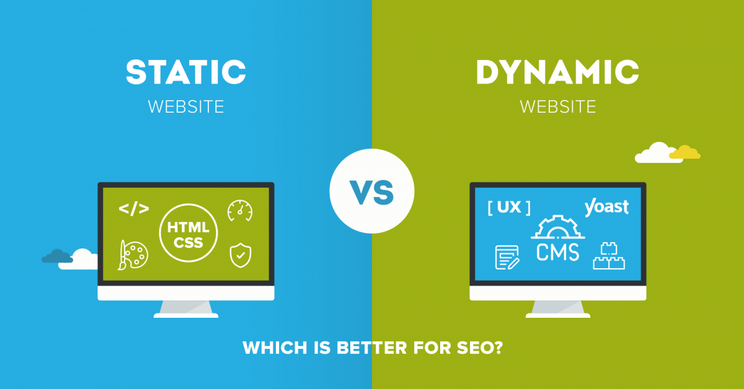
PROJECT 2
Deploy a Static Website
4

Slide 11

What is Static Website?
Static web pages are made of “fixed code,” and unless the site developer makes changes, nothing will change on the page. Think of it like a brochure for a business. Static sites give a lot of the same type of information that you could get from a brochure, but it can't just change itself.
18

Slide 12
STEPS TO GENERATE A STATIC WEBSITE
STEP 1: Create a Bucket
STEP 2: Enable static website hosting
STEP 3: Edit block public accesss
STEP 4: Add a bucket policyt that makes your bucket content publicly available
STEP 5: Configure an index document
STEP 6: Configure an error document
STEP 7: Test your website endpoint
STEP 8: Clean Up
3

Slide 13
Conclusion
The AWS architecture is highly available and scalable, secure, and provides for a responsive user experience at very low cost. By enabling and analyzing the available logs, you can you understand your visitors and how well the website is performing.

Slide 14
THANK YOU!

